Slide 2
Numpy intro
NumPy is a Python package. It stands for 'Numerical Python'. It is a library consisting of
multidimensional array objects and a collection of routines for processing of array.
Numeric, the ancestor of NumPy, was developed by Jim Hugunin.
Another package ‘Numarray’ was also developed, having some additional functionalities.
In 2005, Travis Oliphant created NumPy package by incorporating the features of Numarray into Numeric
package. There are many contributors to this open source project

Slide 3
Numpy
NumPy contains a multi-dimensional array and matrix data structures.
It can be utilised to perform a number of mathematical operations on arrays such as trigonometric, statistical, and linear algebra routines.
NumPy is a wrapper around a library implemented in C.
Pandas objects rely heavily on NumPy objects. Essentially, Pandas extends Numpy.

Slide 4
NumPy – A Replacement for MATLAB??
NumPy is often used along with packages like SciPy (Scientific Python) and Matplotlib(plotting library).
This combination is widely used as a replacement for MATLAB, a popular platform for technical computing.
However, Python alternative to MATLAB is now seen as a more modern and complete programming language.

Slide 5
NumPy’s main object is the homogeneous multi-dimensional array.
It is row/table/rectangular cuboid/etc. of elements (usually numbers), all of the same type, indexed by a tuple of positive integers.
As the name gives away, a NumPy array is a central data structure of the numpy library. The library’s name is short for “Numeric Python” or “Numerical Python”.

Slide 6
what is an array?
A numpy array is a grid of values, all of the same type, and is indexed by a tuple of nonnegative integers. The number of dimensions is the rank of the array; the shape of an array is a tuple of integers giving the size of the array along each dimension

Slide 7
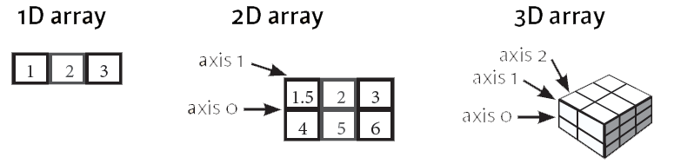
NumPy − ndarray Object
The most important object defined in NumPy is an N-dimensional array type called ndarray.
It describes the collection of items of the same type. Every item in an ndarray takes the same size of block in the memory

Slide 8
NumPy − Array Creation Routines
An instance of ndarray class can be constructed by different array creation routines. The basic ndarray is created using an array function in NumPy as follows:
numpy.array

Slide 9
Array from Existing Data
To make a numpy array, you can just use the np.array() function. All you need to do is pass a list to it, and optionally, you can also specify the data type of the data.
numpy.asarray(object, dtype=None)
Object: Input data in any form such as list, list of tuples, tuples, tuple of tuples or tuple of lists
dtype :By default, the data type of input data is applied to the resultant ndarray
How to do that

Slide 10
How To Load NumPy Arrays From Text
specific functions to load data from your files, such as loadtxt() or genfromtxt()
# This is your data in the text file # Value1 Value2 Value3
# 0.2536 0.1008 0.3857
# 0.4839 0.4536 0.3561
# 0.1292 0.6875 0.5929
# 0.1781 0.3049 0.8928
# 0.6253 0.3486 0.8791
you use loadtxt() to load the data in your environment. You see that the first argument that both functions take is the text file data.txt. Next, there are some specific arguments for each: in the first statement, you skip the first row, and you return the columns as separate arrays with unpack=TRUE. This means that the values in column Value1 will be put in x, and so on.
# Import your data x, y, z = np.loadtxt('data.txt', skiprows=1, unpack=True)
Another function is genfromtxt()

Slide 11
Array from Numerical Ranges
This function returns an ndarray object containing evenly spaced values within a given range
numpy.arange(start, stop, step, dtype)
Start :The start of an interval. If omitted, defaults to 0
Stop :The end of an interval (not including this number)
Step :Spacing between values, default is 1
Dtype :Data type of resulting ndarray. If not given, data type of input is used
How to do that

Slide 12
Numpy data types
NumPy supports a much greater variety of numerical types than Python does
Data Types | Description
bool_ | Boolean (True or False) stored as a byte
int8 | Byte (-128 to 127)
int16 | Integer (-32768 to 32767)
uint8 | Unsigned integer (0 to 255)
float_ | Shorthand for float64
complex_ | Shorthand for complex128

Slide 13
Numpy Attributes
Numpy attributes gives us the info about the array
Each array from the defined values respectively have certain attributes which include
a) ndim (number of the dimensions) of the array.
b) shape(the size of each dimensions)
c) size(the total size of the array)
d) dtype(describes the data type of the array)

Slide 14
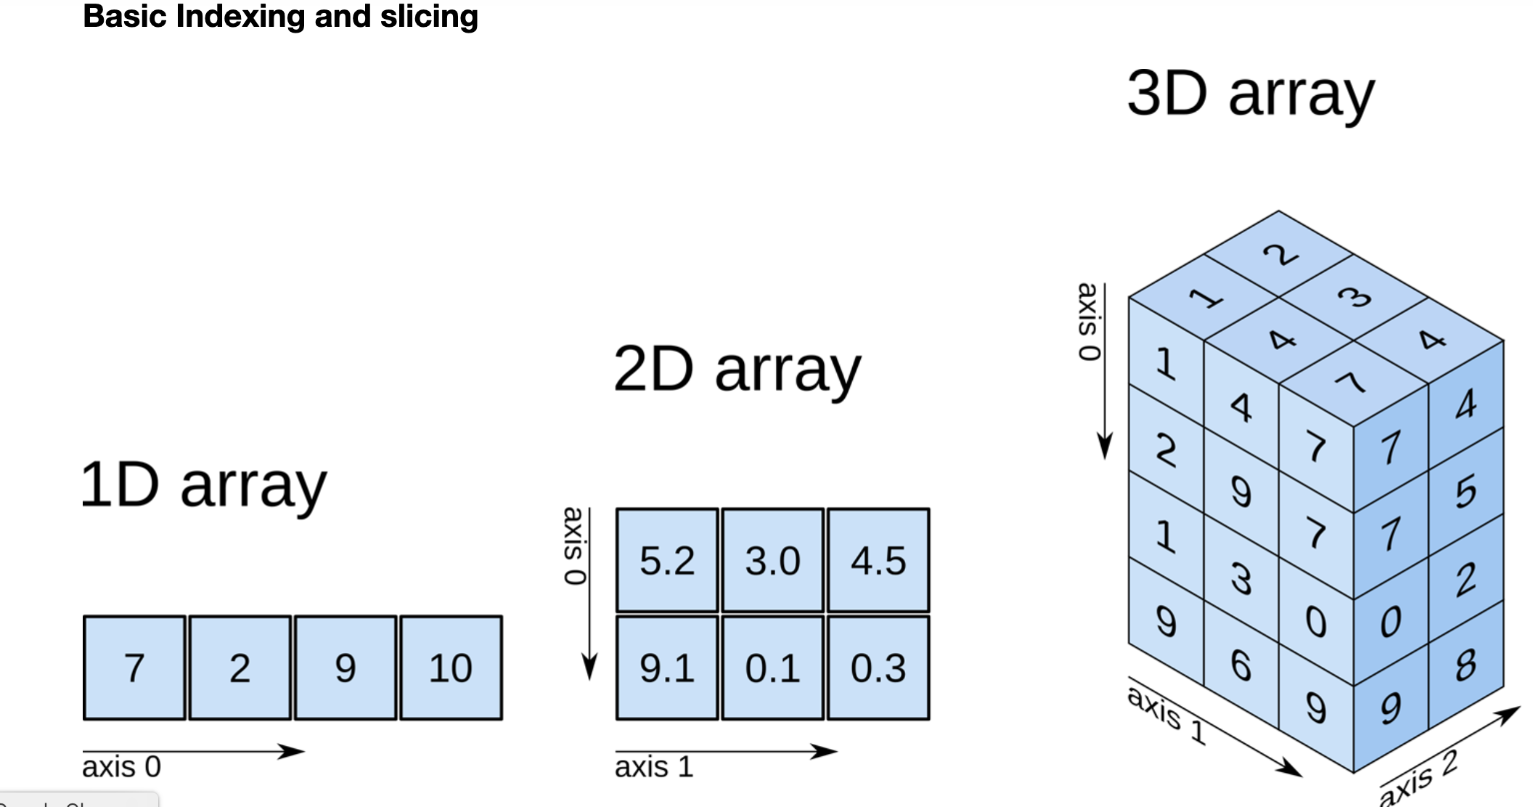
Indexing & Slicing
Items in ndarray object follows zero-based index.
Three types of indexing methods are available: field access, basic slicing and advanced indexing.
A Python slice object is constructed by giving start, stop, and step parameters to the built-in slice
function. This slice object is passed to the array to extract a part of array
array[start:stop:step]

Slide 15
Indexing elements in a NumPy array

Slide 16
Advanced Indexing
It is possible to make a selection from ndarray that is a non-tuple sequence, ndarray object of integer or Boolean data type, or a tuple with at least one item being a sequence object.
There are two types of advanced indexing: Integer and Boolean.
Integer :
This mechanism helps in selecting any arbitrary item in an array based on its Ndimensional index.
Boolean :
This type of advanced indexing is used when the resultant object is meant to be the result
of Boolean operations, such as comparison operators
How to do that

Slide 17
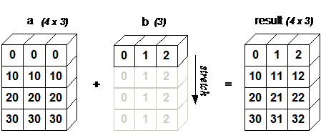
Broadcasting
Broadcasting is the ability of NumPy to treat arrays of different shapes during arithmetic operations. Arithmetic operations on arrays are usually done on corresponding elements.
How to do that

Slide 18
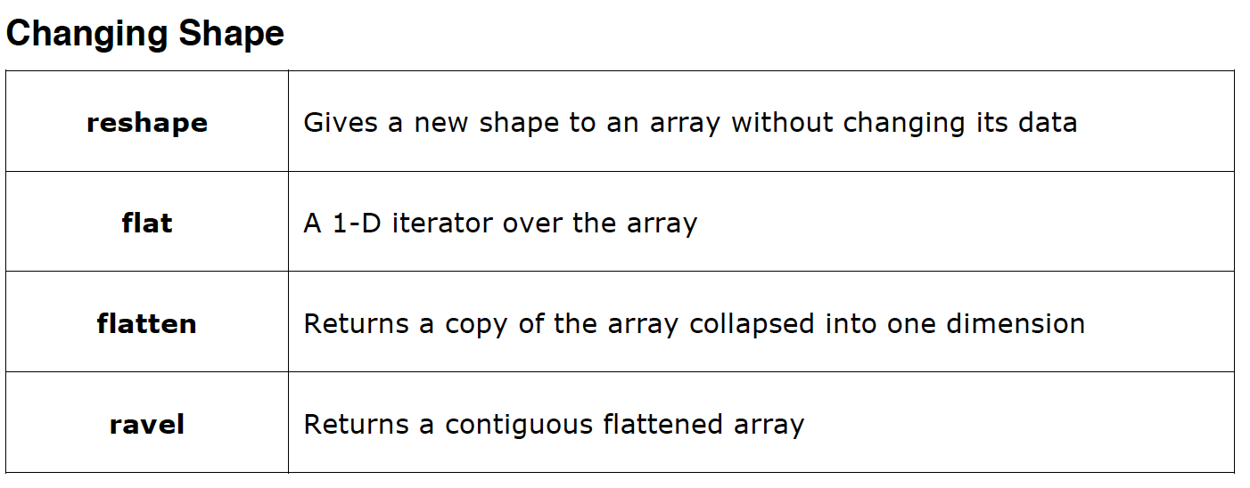
Array Manipulation
Several routines are available in NumPy package for manipulation of elements in ndarray object. They can be classified into the following types
How to do that

Slide 19
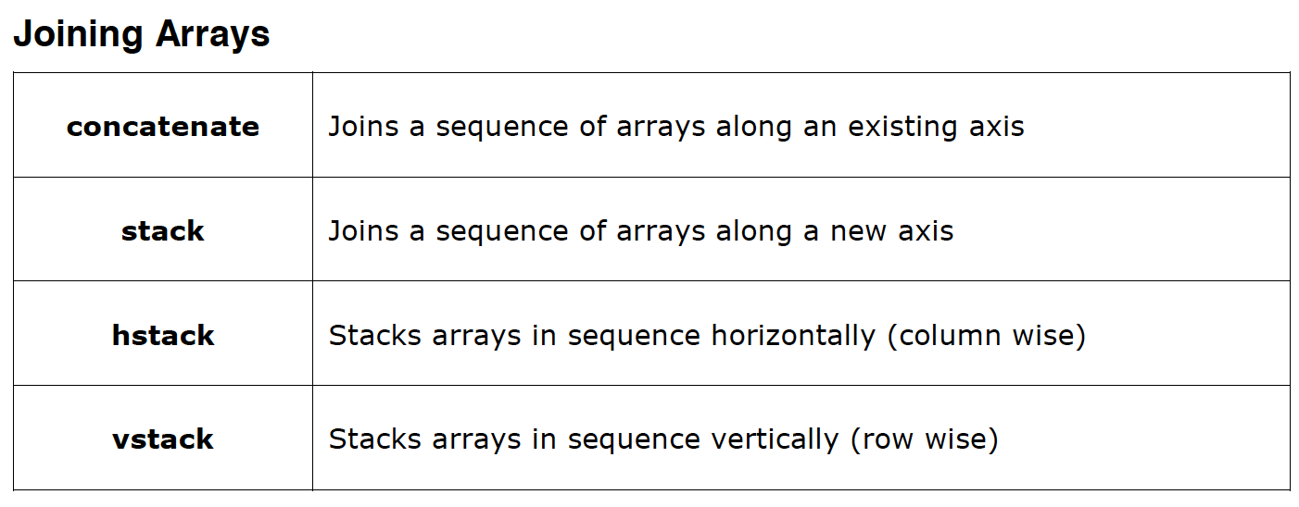
How to do that

Slide 20
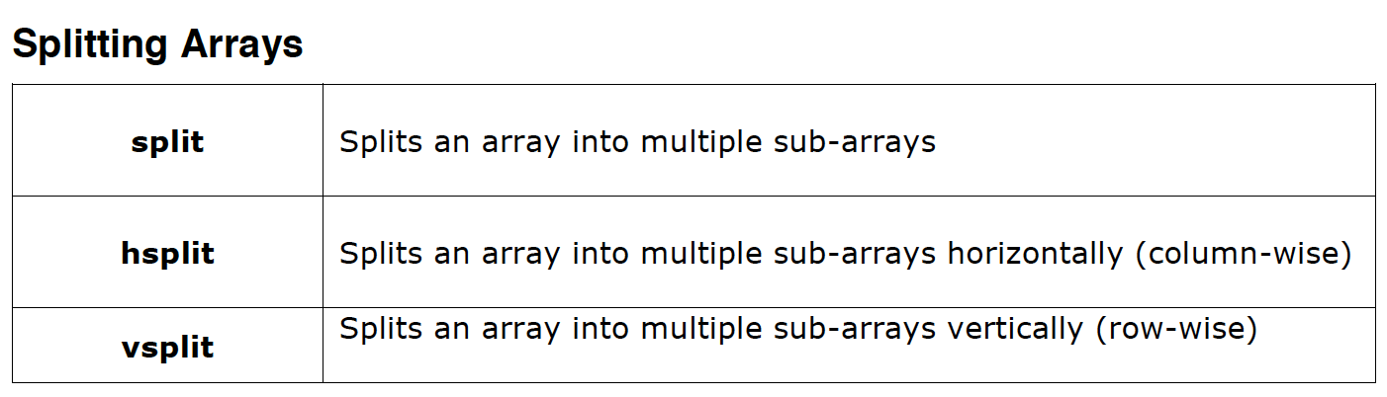

Slide 21
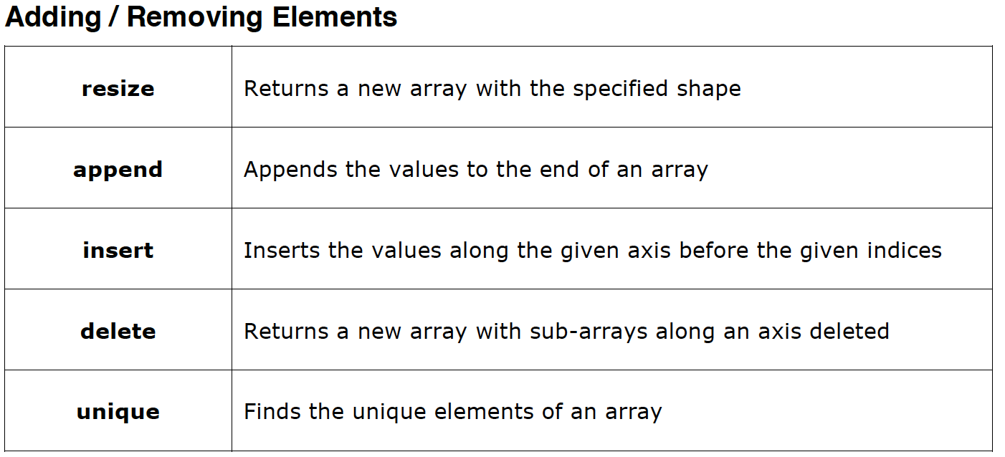

Slide 22
String Functions
add() | Concatenate two strings
capitalize() | first letter capitalized
title() | first letter of each word capitalized.
lower() | convert to lowercase
upper() | convert to upper case
split() | returns a list of words in the input string
strip() | strip of the specified characters leading and/or trailing in it
join() | returns a string in which the individual characters are joined by separator
replace() | string in which all occurrences of the sequence of characters is replaced by another given sequence

Slide 23
Arithmetic Operations
Arithmetic operations such as add(), subtract(), multiply(), power(), and divide()

Slide 24
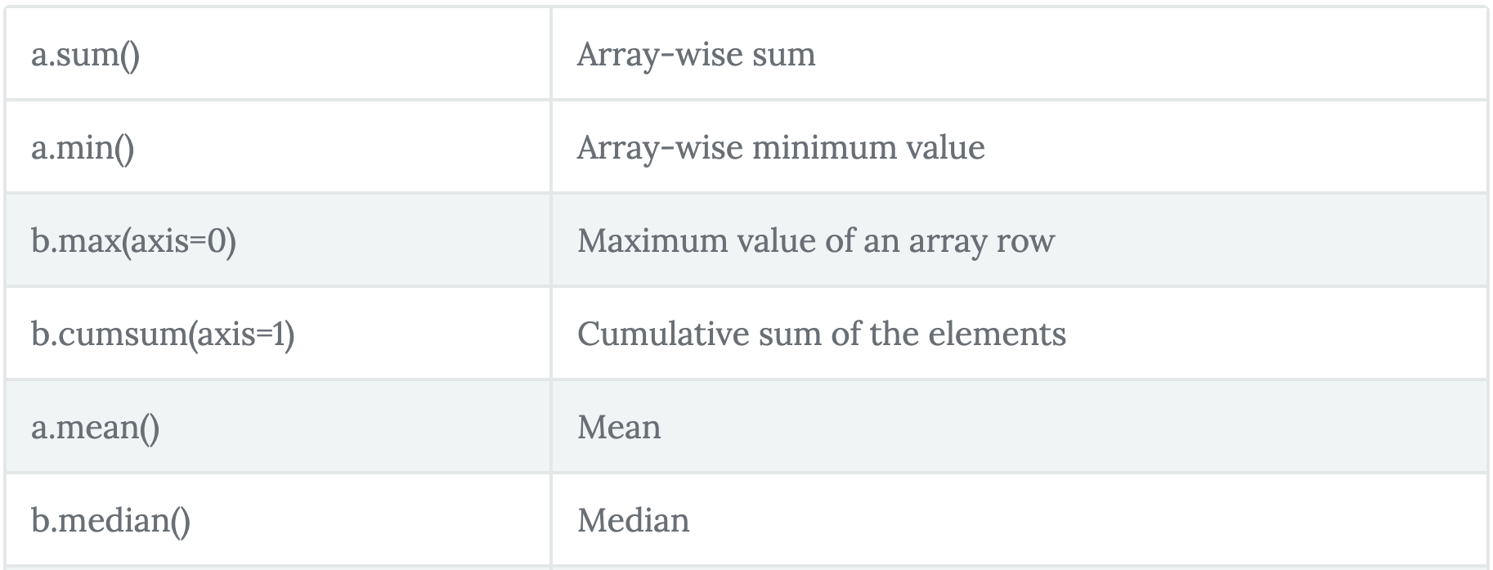
Statistical Functions

Slide 25
Sort, Search & Counting
Numpy.sort()
numpy.where()

Slide 26
Matrix operations
NumPy package contains a Matrix library numpy.matlib. This module has functions that
return matrices instead of ndarray objects

Slide 27
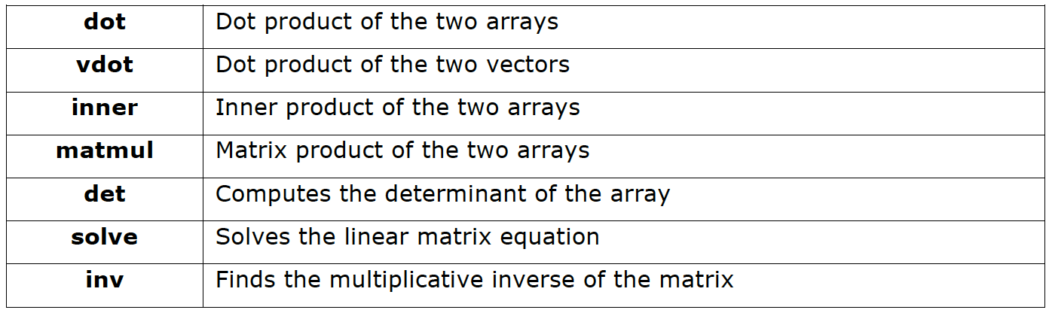
Linear Algebra
NumPy package contains numpy.linalg module that provides all the functionality required for linear algebra

Slide 28
Thank you

